Slide 1
spectrum
unlock the strength of diversity

Slide 2
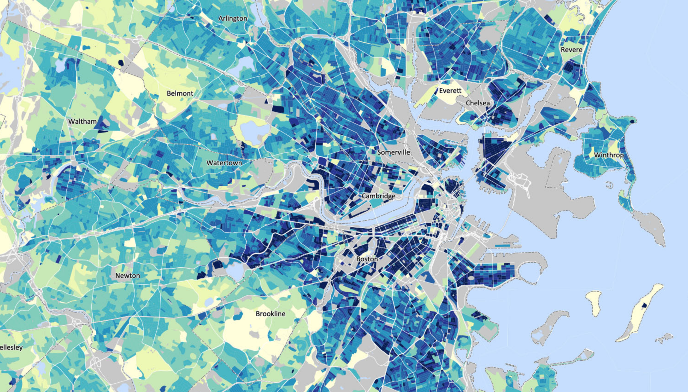
login
MY ANALYTICS
RESOURCES
VOLUNTEER
LEARNING COMMUNITY
earns spectrum award
for second straight year
how do top companies conduct outreach to achieve a truly diverse candidate pool?
does your company represent the
community where you live and work? find out!
spectrum
AWARD
2016

Slide 3
login
MY ANALYTICS
RESOURCES
VOLUNTEER
LEARNING COMMUNITY
earns spectrum award
for second straight year
spectrum
AWARD
2016

Slide 4
login
MY ANALYTICS
RESOURCES
VOLUNTEER
LEARNING COMMUNITY
Have an account?
|
email or username
password
Remember me • Forgot password?
Log In
New to Spectrum?
Sign Up
earns spectrum award
for second straight year
spectrum
AWARD
2016

Slide 5
login
MY ANALYTICS
RESOURCES
VOLUNTEER
LEARNING COMMUNITY
Have an account?
dfutrell
|
********
Remember me • Forgot password?
Log In
New to Spectrum?
Sign Up
earns spectrum award
for second straight year
spectrum
AWARD
2016

Slide 6
MY ANALYTICS
RESOURCES
VOLUNTEER
LEARNING COMMUNITY
earns spectrum award
for second straight year
spectrum
AWARD
2016

Slide 7
MY ANALYTICS
RESOURCES
VOLUNTEER
LEARNING COMMUNITY
Goals –
gender
race
Favorite Reports +
Compare MediaMath with industry companies in location with company size by dimension using which data

Slide 8
spectrum
MY ANALYTICS
RESOURCES
VOLUNTEER
LEARNING COMMUNITY
Compare MediaMath with industry companies in location with company size by dimension using which data
hospitality
human resources
import and export
individual & family services
industrial automation
information services
information technology and services
Insurance
international affairs
international trade and development
internet
investment banking
investment management
judiciary
law enforcement
law practice
legal services
legislative office
leisure, travel & tourism
libraries
logistics and supply chain

Slide 9
MY ANALYTICS
RESOURCES
VOLUNTEER
LEARNING COMMUNITY
Goals –
gender
race
Favorite Reports +
Compare MediaMath with internet companies in location with company size by dimension using which data

Slide 10
spectrum
MY ANALYTICS
RESOURCES
VOLUNTEER
LEARNING COMMUNITY
Compare MediaMath with internet companies in location with company size by dimension using which data
Boston
Chicago
San Francisco
Miami
New York
Greater Boston metro area
Massachusetts
New England
United States of America

Slide 11
MY ANALYTICS
RESOURCES
VOLUNTEER
LEARNING COMMUNITY
Goals –
gender
race
Favorite Reports +
Compare MediaMath with internet companies in Boston with company size by dimension using which data

Slide 12
spectrum
MY ANALYTICS
RESOURCES
VOLUNTEER
LEARNING COMMUNITY
Compare MediaMath with internet companies in Boston with company size by dimension using which data
1 to 4 employees
5 to 9 employees
10 to 19 employees
20 to 49 employees
50 to 99 employees
100 to 249 employees
250 to 499 employees
500 to 999 employees
1,000 or more employees

Slide 13
MY ANALYTICS
RESOURCES
VOLUNTEER
LEARNING COMMUNITY
Goals –
gender
race
Favorite Reports +
Compare MediaMath with internet companies in Boston with 500-999 employees by dimension using which data

Slide 14
spectrum
MY ANALYTICS
RESOURCES
VOLUNTEER
LEARNING COMMUNITY
Compare MediaMath with internet companies in Boston with 500-999 employees by dimension using which data
gender
race
age
sexual orientation
physical & mental ability
socioeconomic background

Slide 15
MY ANALYTICS
RESOURCES
VOLUNTEER
LEARNING COMMUNITY
Goals –
gender
race
Favorite Reports +
Compare MediaMath with internet companies in Boston with 500-999 employees by age using which data

Slide 16
spectrum
MY ANALYTICS
RESOURCES
VOLUNTEER
LEARNING COMMUNITY
Compare MediaMath with internet companies in Boston with 500-999 employees by age using which data
today’s data
data from the past 12 months
data from the past 2 years
data from the past 5 years

Slide 17
MY ANALYTICS
RESOURCES
VOLUNTEER
LEARNING COMMUNITY
Compare MediaMath with internet companies in Boston with 500-999 employees by age using today’s data

Slide 18


MY ANALYTICS
RESOURCES
VOLUNTEER
LEARNING COMMUNITY
Compare MediaMath with internet companies in Boston with 500-999 employees by age using today’s data
2016 Goal
 | MediaMath |  |  | Internet Companies in Boston with 500-999 employees
Age Categories ▲ | Number of employees ▼ | Percent of employees ▼ | 2016 Goal | Number of employees ▼ | Percent of employees ▼
Employees aged 18 - 19 | 0 | 0% | - | 1,209 | 2%
Employees aged 20 - 24 | 143 | 19% | 17% | 7,860 | 13%
Employees aged 25- 29 | 218 | 29% | 23% | 14,510 | 24%
Employees aged 30 - 34 | 240 | 32% | 29% | 18,742 | 31%
Employees aged 35 - 39 | 105 | 14% | 15% | 7,255 | 12%
Employees aged 40 - 44 | 23 | 3% | 10% | 5,441 | 9%
Employees aged 45 - 49 | 22 | 3% | 5% | 2,418 | 4%
Employees aged 50 - 54 | 0 | 0% | 3% | 1,209 | 2%
Employees aged 55 - 59 | 0 | 0% | 2% | 1,209 | 2%
Employees aged 60 - 64 | 0 | 0% | - | 605 | 1%
Employees aged 65 - 69 | 0 | 0% | - | 0 | 0%
Employees aged 70 - 74 | 0 | 0% | - | 0 | 0%
Employees aged 75 + | 0 | 0% | - | 0 | 0%

Slide 19
MY ANALYTICS
RESOURCES
VOLUNTEER
LEARNING COMMUNITY
Compare MediaMath with internet companies in Boston with 500-999 employees by age using today’s data
2016 Goal
 | MediaMath |  |  | Internet Companies in Boston with 500-999 employees
Age Categories ▲ | Number of employees ▼ | Percent of employees ▼ | 2016 Goal | Number of employees ▼ | Percent of employees ▼
Employees aged 18 - 19 | 0 | 0% | - | 1,209 | 2%
Employees aged 20 - 24 | 143 | 19% | 17% | 7,860 | 13%
Employees aged 25- 29 | 218 | 29% | 23% | 14,510 | 24%
Employees aged 30 - 34 | 240 | 32% | 29% | 18,742 | 31%
Employees aged 35 - 39 | 105 | 14% | 15% | 7,255 | 12%
Employees aged 40 - 44 | 23 | 3% | 10% | 5,441 | 9%
Employees aged 45 - 49 | 22 | 3% | 5% | 2,418 | 4%
Employees aged 50 - 54 | 0 | 0% | 3% | 1,209 | 2%
Employees aged 55 - 59 | 0 | 0% | 2% | 1,209 | 2%
Employees aged 60 - 64 | 0 | 0% | - | 605 | 1%
Employees aged 65 - 69 | 0 | 0% | - | 0 | 0%
Employees aged 70 - 74 | 0 | 0% | - | 0 | 0%
Employees aged 75 + | 0 | 0% | - | 0 | 0%

Slide 20
spectrum
MY ANALYTICS
RESOURCES
VOLUNTEER
LEARNING COMMUNITY
Compare MediaMath with internet companies in Boston with 500-999 employees by age using today’s data
Boston
Chicago
San Francisco
Miami
New York
Greater Boston metro area
Massachusetts
New England
United States of America
2016 Goal
 | MediaMath |  |  | Internet Companies in Boston with 500-999 employees
Age Categories ▲ | Number of employees ▼ | Percent of employees ▼ | 2016 Goal | Number of employees ▼ | Percent of employees ▼
Employees aged 18 - 19 | 0 | 0% | - | 1,209 | 2%
Employees aged 20 - 24 | 143 | 19% | 17% | 7,860 | 13%
Employees aged 25- 29 | 218 | 29% | 23% | 14,510 | 24%
Employees aged 30 - 34 | 240 | 32% | 29% | 18,742 | 31%
Employees aged 35 - 39 | 105 | 14% | 15% | 7,255 | 12%
Employees aged 40 - 44 | 23 | 3% | 10% | 5,441 | 9%
Employees aged 45 - 49 | 22 | 3% | 5% | 2,418 | 4%
Employees aged 50 - 54 | 0 | 0% | 3% | 1,209 | 2%
Employees aged 55 - 59 | 0 | 0% | 2% | 1,209 | 2%
Employees aged 60 - 64 | 0 | 0% | - | 605 | 1%
Employees aged 65 - 69 | 0 | 0% | - | 0 | 0%
Employees aged 70 - 74 | 0 | 0% | - | 0 | 0%
Employees aged 75 + | 0 | 0% | - | 0 | 0%

Slide 21
MY ANALYTICS
RESOURCES
VOLUNTEER
LEARNING COMMUNITY
Compare MediaMath with internet companies in New York with 500-999 employees by age using today’s data
2016 Goal
 | MediaMath |  |  | Internet Companies in New York with 500-999 employees
Age Categories ▲ | Number of employees ▼ | Percent of employees ▼ | 2016 Goal | Number of employees ▼ | Percent of employees ▼
New York | 0 | 0% | - | 1,209 | 2%
Employees aged 20 - 24 | 143 | 19% | 17% | 7,860 | 13%
Employees aged 25- 29 | 218 | 29% | 23% | 14,510 | 24%
Employees aged 30 - 34 | 240 | 32% | 29% | 18,742 | 31%
Employees aged 35 - 39 | 105 | 14% | 15% | 7,255 | 12%
Employees aged 40 - 44 | 23 | 3% | 10% | 5,441 | 9%
Employees aged 45 - 49 | 22 | 3% | 5% | 2,418 | 4%
Employees aged 50 - 54 | 0 | 0% | 3% | 1,209 | 2%
Employees aged 55 - 59 | 0 | 0% | 2% | 1,209 | 2%
Employees aged 60 - 64 | 0 | 0% | - | 605 | 1%
Employees aged 65 - 69 | 0 | 0% | - | 0 | 0%
Employees aged 70 - 74 | 0 | 0% | - | 0 | 0%
Employees aged 75 + | 0 | 0% | - | 0 | 0%

Slide 22
MY ANALYTICS
RESOURCES
VOLUNTEER
LEARNING COMMUNITY
Compare MediaMath with internet companies in New York with 500-999 employees by age using today’s data
Boston
Chicago
San Francisco
Miami
New York
Greater Boston metro area
Massachusetts
New England
United States of America
2016 Goal
 | MediaMath |  |  | Internet Companies in New York with 500-999 employees
Age Categories ▲ | Number of employees ▼ | Percent of employees ▼ | 2016 Goal | Number of employees ▼ | Percent of employees ▼
New York | 0 | 0% | - | 1,209 | 2%
Employees aged 20 - 24 | 143 | 19% | 17% | 7,860 | 13%
Employees aged 25- 29 | 218 | 29% | 23% | 14,510 | 24%
Employees aged 30 - 34 | 240 | 32% | 29% | 18,742 | 31%
Employees aged 35 - 39 | 105 | 14% | 15% | 7,255 | 12%
Employees aged 40 - 44 | 23 | 3% | 10% | 5,441 | 9%
Employees aged 45 - 49 | 22 | 3% | 5% | 2,418 | 4%
Employees aged 50 - 54 | 0 | 0% | 3% | 1,209 | 2%
Employees aged 55 - 59 | 0 | 0% | 2% | 1,209 | 2%
Employees aged 60 - 64 | 0 | 0% | - | 605 | 1%
Employees aged 65 - 69 | 0 | 0% | - | 0 | 0%
Employees aged 70 - 74 | 0 | 0% | - | 0 | 0%
Employees aged 75 + | 0 | 0% | - | 0 | 0%

Slide 23
MY ANALYTICS
RESOURCES
VOLUNTEER
LEARNING COMMUNITY
Compare MediaMath with internet companies in Boston with 500-999 employees by age using today’s data
2016 Goal
gender
race
age
sexual orientation
physical & mental ability
socioeconomic background
 | MediaMath |  |  | Internet Companies in New York with 500-999 employees
Age Categories ▲ | Number of employees ▼ | Percent of employees ▼ | 2016 Goal | Number of employees ▼ | Percent of employees ▼
New York | 0 | 0% | - | 1,209 | 2%
Employees aged 20 - 24 | 143 | 19% | 17% | 7,860 | 13%
Employees aged 25- 29 | 218 | 29% | 23% | 14,510 | 24%
Employees aged 30 - 34 | 240 | 32% | 29% | 18,742 | 31%
Employees aged 35 - 39 | 105 | 14% | 15% | 7,255 | 12%
Employees aged 40 - 44 | 23 | 3% | 10% | 5,441 | 9%
Employees aged 45 - 49 | 22 | 3% | 5% | 2,418 | 4%
Employees aged 50 - 54 | 0 | 0% | 3% | 1,209 | 2%
Employees aged 55 - 59 | 0 | 0% | 2% | 1,209 | 2%
Employees aged 60 - 64 | 0 | 0% | - | 605 | 1%
Employees aged 65 - 69 | 0 | 0% | - | 0 | 0%
Employees aged 70 - 74 | 0 | 0% | - | 0 | 0%
Employees aged 75 + | 0 | 0% | - | 0 | 0%

Slide 24
MY ANALYTICS
RESOURCES
VOLUNTEER
LEARNING COMMUNITY
Compare MediaMath with internet companies in Boston with 500-999 employees by gender using today’s data

Slide 25
MY ANALYTICS
RESOURCES
VOLUNTEER
LEARNING COMMUNITY
Compare MediaMath with internet companies in Boston with 500-999 employees by gender using today’s data
2016 Goal
 | MediaMath |  |  | Internet Companies in Boston with 500-999 employees
Gender ▲ | Number of employees ▼ | Percent of employees ▼ | 2016 Goal | Number of employees ▼ | Percent of employees ▼
Male | 585 | 78% | 68% | 42,926 | 71%
Female | 165 | 22% | 32% | 16,929 | 28%
Other | 0 | 0% | - | 605 | 1%

Slide 26
MY ANALYTICS
RESOURCES
VOLUNTEER
LEARNING COMMUNITY
Compare MediaMath with internet companies in Boston with 500-999 employees by gender using today’s data
2016 Goal
 | MediaMath |  |  | Internet Companies in Boston with 500-999 employees
Gender ▲ | Number of employees ▼ | Percent of employees ▼ | 2016 Goal | Number of employees ▼ | Percent of employees ▼
Male | 585 | 78% | 68% | 42,926 | 71%
Female | 165 | 22% | 32% | 16,929 | 28%
Other | 0 | 0% | - | 605 | 1%

Slide 27
spectrum
MY ANALYTICS
RESOURCES
VOLUNTEER
LEARNING COMMUNITY
Invest in tools, training programs, and/or resources that assist with mitigating bias in recruiting, hiring, and employment.

Slide 28
spectrum
MY ANALYTICS
RESOURCES
VOLUNTEER
LEARNING COMMUNITY
Which MediaMath office? pick a location
Which dimension of diversity? pick a dimension

Slide 29
spectrum
MY ANALYTICS
RESOURCES
VOLUNTEER
LEARNING COMMUNITY
Which MediaMath office? pick a location
Which dimension of diversity? pick a dimension
Boston
Chicago
San Francisco
Miami
New York

Slide 30
MY ANALYTICS
RESOURCES
VOLUNTEER
LEARNING COMMUNITY
Which MediaMath office? Boston
Which dimension of diversity? pick a dimension

Slide 31
MY ANALYTICS
RESOURCES
VOLUNTEER
LEARNING COMMUNITY
Which MediaMath office? Boston
Which dimension of diversity? pick a dimension
age
gender
mental ability
physical ability
race & ethnicity
sexual orientation
socioeconomics

Slide 32
MY ANALYTICS
RESOURCES
VOLUNTEER
LEARNING COMMUNITY
Which MediaMath office? Boston
Which dimension of diversity? Socioeconomics

Slide 33
spectrum
MY ANALYTICS
RESOURCES
VOLUNTEER
LEARNING COMMUNITY
Which MediaMath office? Boston
Which dimension of diversity? Socioeconomics

Slide 34
spectrum
MY ANALYTICS
RESOURCES
VOLUNTEER
LEARNING COMMUNITY
Message News Feed
Conversations ^{BETA}
Categories –
age
culture
diversity as strength
gender
hiring & recruiting
mental ability
physical ability
race & ethnicity
sexual orientation
socioeconomics
My Posts
Search all posts
SEARCH
NEW POST
Trending Now
Full time open-source data visualization web developer at Kitware (1)
Age | Gender | By Jeff Baumes - 1 post - 64 views
4:32pm, Thursday, Jan 21
Full time open-source data visualization web developer at Kitware (1)
Age | Gender | By Jeff Baumes - 1 post - 64 views
4:31pm, Thursday, Jan 21
Full time open-source data visualization web developer at Kitware (1)
Age | Gender | By Jeff Baumes - 1 post - 64 views
4:05pm, Thursday, Jan 21
Search Results
Full time open-source data visualization web developer at Kitware (1)
Age | Gender | By Jeff Baumes - 1 post - 64 views
3:36pm, Thursday, Jan 21
Full time open-source data visualization web developer at Kitware (1)
Age | Gender | By Jeff Baumes - 1 post - 64 views
3:29pm, Thursday, Jan 21
Full time open-source data visualization web developer at Kitware (1)
Age | Gender | By Jeff Baumes - 1 post - 64 views
3:10pm, Thursday, Jan 21
Full time open-source data visualization web developer at Kitware (1)
Age | Gender | By Jeff Baumes - 1 post - 64 views
3:03pm, Thursday, Jan 21
Full time open-source data visualization web developer at Kitware (1)
Age | Gender | By Jeff Baumes - 1 post - 64 views
2:59pm, Thursday, Jan 21
Full time open-source data visualization web developer at Kitware (1)
Age | Gender | By Jeff Baumes - 1 post - 64 views
2:54pm, Thursday, Jan 21
Full time open-source data visualization web developer at Kitware (1)
Age | Gender | By Jeff Baumes - 1 post - 64 views
2:13pm, Thursday, Jan 21
Full time open-source data visualization web developer at Kitware (1)
Age | Gender | By Jeff Baumes - 1 post - 64 views
2:09pm, Thursday, Jan 21
Full time open-source data visualization web developer at Kitware (1)
Age | Gender | By Jeff Baumes - 1 post - 64 views
2:08pm, Thursday, Jan 21
Full time open-source data visualization web developer at Kitware (1)
Age | Gender | By Jeff Baumes - 1 post - 64 views
1:41pm, Thursday, Jan 21
Full time open-source data visualization web developer at Kitware (1)
Age | Gender | By Jeff Baumes - 1 post - 64 views
1:38pm, Thursday, Jan 21
Full time open-source data visualization web developer at Kitware (1)
Age | Gender | By Jeff Baumes - 1 post - 64 views
1:30pm, Thursday, Jan 21
Full time open-source data visualization web developer at Kitware (1)
Age | Gender | By Jeff Baumes - 1 post - 64 views
1:24pm, Thursday, Jan 21
Full time open-source data visualization web developer at Kitware (1)
Age | Gender | By Jeff Baumes - 1 post - 64 views
1:01pm, Thursday, Jan 21

Slide 35
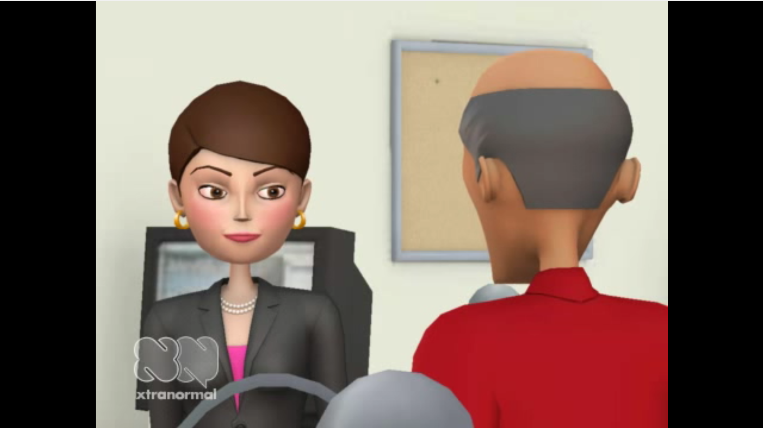
spectrum
MY ANALYTICS
RESOURCES
VOLUNTEER
LEARNING COMMUNITY
Message News Feed
Conversations ^{BETA}
Categories –
age
culture
diversity as strength
gender
hiring & recruiting
mental ability
physical ability
race & ethnicity
sexual orientation
socioeconomics
My Posts
Search all conversations
SEARCH
Upcoming | Recent
Building your candidate pool
Diversity as Strength | By Tom Skillet - 164 views
Tom Skillet, Senior VP of Human Resources for General Tesla, talks about how his team sets goals for building a diverse candidate pool, and the outreach it takes to find the best talent and the perfect fit from that pool.
Training your interview team
Age | Gender | By Jeff Baumes - 1 post - 64 views
Diversity as a strength at Year Up
Age | Gender | By Jeff Baumes - 1 post - 64 views
City of Tacoma prioritizes socioeconomic background in workforce
Age | Gender | By Jeff Baumes - 1 post - 64 views

Slide 36
spectrum
unlock the strength of diversity

Slide 37
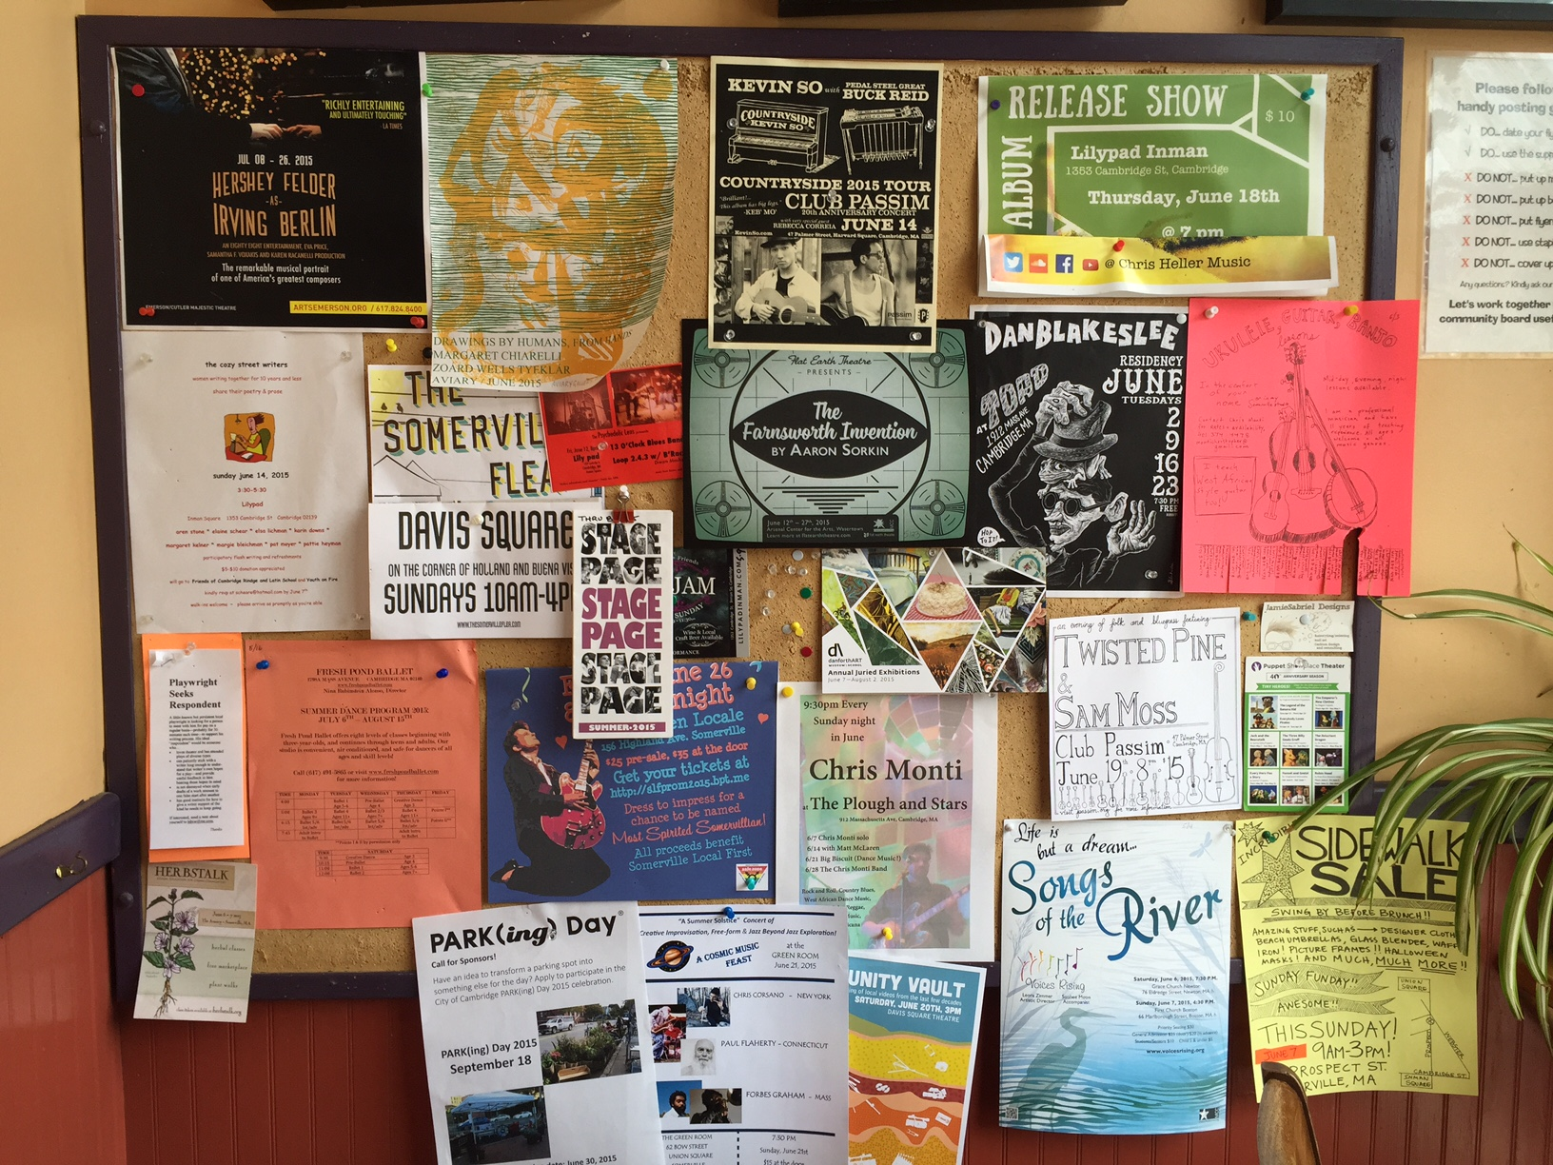
This phone number is going in the washing machine in my jeans pocket. No guitar lessons for me.
Recurring events all summer? Should I grab the only pamphlet? I’d love to just subscribe to a Google calendar or join a mailing list.
Does anyone read this? I wouldn’t know because I didn’t do A/B testing.
That’s a lot of info. Should I write it down or take a photo and forget about it? Can’t you just send it to me?
Sidewalk Sale? Down low and covered by plants.
The Plough & Stars, a local pub, probably could do something better with their time than travel to every local coffee shop to advertise.
Maybe I’d like this, but I wouldn’t know. The next guy covered it up.

Slide 38
How corkboards work today
?
?
Decide to advertise locally
Select locations
Which message works?
Create media
Is there capacity?
?
Travel to locations
How many people visit each location?
Post media
?
?
Which days are best?
Determine capacity available
Was my ad taken down?
Minimal attribution
?
Receive inbounds
?
Is my ad still up?
Assume ad was taken down
Was it effective?
?
Repeat?

Slide 39
How cork works
PLAN
Decide to advertise locally
Create media
A/B Test Media
Analyze placement & target
Select locations
EXECUTE
Instantly post media
Maximize capacity
Control your message
Requested data input
ANALYZE
Receive inbounds & leads
See ad attribution
Improve efficiency
Iterate

Slide 40
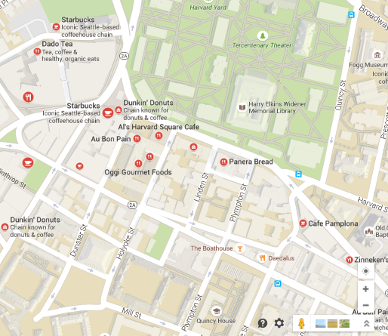
CAMPAIGN
LEADS
ANALYTICS
MEDIA
Build Campaign
CAMPAIGN: Memorial Day Special
Details
Harvard Square, Cambridge, MA
SEARCH
Select Locations
Café Zing, Porter Square Sh…
Bourbon Coffee, 1815 Mass…
Café Rustica, 356 Beacon St…
Dado Tea, The Atrium Shop…
Starbucks, 1380 Massachus…
Peet’s Coffee & Tea, 100 Mt…
Crema Cafe, The Atrium Sh…
Starbucks, 36 John F. Kenne…
Dunkin’ Donuts, 61 Church …
Starbucks, 31 Church Street…
Oggi Gourmet Foods, 1350 …
Location
✔
✔
Media
✔
Targeting
✔
Activate
BACK
NEXT

Slide 41
CAMPAIGN
LEADS
ANALYTICS
MEDIA
Build Campaign
CAMPAIGN: Memorial Day Special
Details
Accepted formats: .PDF, .DOC, .PPT, .PNG, .GIF, .JPEG
Location
Add another file
Media
 | Name | Date | Size
 | Thu/Fri Pre-Weekend Special in Cambridge.pdf | May 28, 2015 | 1.7MB
 | Summer Weekday Special in Cambridge.pdf | May 28, 2015 | 1.9MB
✔
Targeting
✔
Activate
BACK
NEXT

Slide 42



CAMPAIGN
LEADS
ANALYTICS
MEDIA
Campaigns
Archive
Current
Memorial Day Speci…
Locations (near 02143)
All Available
Previously Targeted
Café Zing, Porter Squar…
Bourbon Coffee, 1815 …
Café Rustica, 356 Beac…
Crema Café, The Atriu…
Media
All Available
Previously Used
Thu/Fri Pre-Weekend S…
Summer Weekday Spe…
Export Data
Find a contact
SEARCH
Filter by
Date
Campaign
Media
Location
i
i
i
i
i
i
 | Contact Name | Campaign | Media | Location | Date | Email | Phone
 | Shanelle Valente | Memorial Day Special 2015 | Thu/Fri Pre-Weekend Special in Cambridge.pdf | Café Zing, Porter Square Sh… | 5/21/2015 | emailaddy@gmail.com | 555-555-5555
 | Tempie Schmelzer | Memorial Day Special 2015 | Thu/Fri Pre-Weekend Special in Cambridge.pdf | Bourbon Coffee, 1815 Mass… | 5/21/2015 | emailaddy@gmail.com | 555-555-5555
 | Dennise Rinehart | Memorial Day Special 2015 | Summer Weekday Special in Cambridge.pdf | Café Rustica, 356 Beacon St… | 5/21/2015 | emailaddy@gmail.com | 555-555-5555
 | Willie Finkel | Memorial Day Special 2015 | Thu/Fri Pre-Weekend Special in Cambridge.pdf | Crema Cafe, The Atrium Sh… | 5/21/2015 | emailaddy@gmail.com | 555-555-5555
 | Jarred Selke | Memorial Day Special 2015 | Summer Weekday Special in Cambridge.pdf | Café Zing, Porter Square Sh… | 5/21/2015 | emailaddy@gmail.com | 555-555-5555
 | Shenna Usrey | Memorial Day Special 2015 | Thu/Fri Pre-Weekend Special in Cambridge.pdf | Bourbon Coffee, 1815 Mass… | 5/21/2015 | emailaddy@gmail.com | 555-555-5555
 | Charley Fix | Memorial Day Special 2015 | Summer Weekday Special in Cambridge.pdf | Bourbon Coffee, 1815 Mass… | 5/21/2015 | emailaddy@gmail.com | 555-555-5555
 | Giovanni Suniga | Memorial Day Special 2015 | Summer Weekday Special in Cambridge.pdf | Café Zing, Porter Square Sh… | 5/21/2015 | emailaddy@gmail.com | 555-555-5555
 | Marvella Ford | Memorial Day Special 2015 | Thu/Fri Pre-Weekend Special in Cambridge.pdf | Café Rustica, 356 Beacon St… | 5/21/2015 | emailaddy@gmail.com | 555-555-5555
 | Jacalyn Baltzell | Memorial Day Special 2015 | Thu/Fri Pre-Weekend Special in Cambridge.pdf | Café Rustica, 356 Beacon St… | 5/21/2015 | emailaddy@gmail.com | 555-555-5555
 | Tinisha Paulos | Memorial Day Special 2015 | Summer Weekday Special in Cambridge.pdf | Café Zing, Porter Square Sh… | 5/21/2015 | emailaddy@gmail.com | 555-555-5555
 | Shira Canale | Memorial Day Special 2015 | Summer Weekday Special in Cambridge.pdf | Café Zing, Porter Square Sh… | 5/21/2015 | emailaddy@gmail.com | 555-555-5555
 | Johnathan Kelton | Memorial Day Special 2015 | Thu/Fri Pre-Weekend Special in Cambridge.pdf | Café Zing, Porter Square Sh… | 5/21/2015 | emailaddy@gmail.com | 555-555-5555
 | Eugene Huey | Memorial Day Special 2015 | Summer Weekday Special in Cambridge.pdf | Bourbon Coffee, 1815 Mass… | 5/21/2015 | emailaddy@gmail.com | 555-555-5555
 | Gary Leitner | Memorial Day Special 2015 | Thu/Fri Pre-Weekend Special in Cambridge.pdf | Crema Cafe, The Atrium Sh… | 5/21/2015 | emailaddy@gmail.com | 555-555-5555
 | Curtis Theobald | Memorial Day Special 2015 | Summer Weekday Special in Cambridge.pdf | Crema Cafe, The Atrium Sh… | 5/21/2015 | emailaddy@gmail.com | 555-555-5555

Slide 43
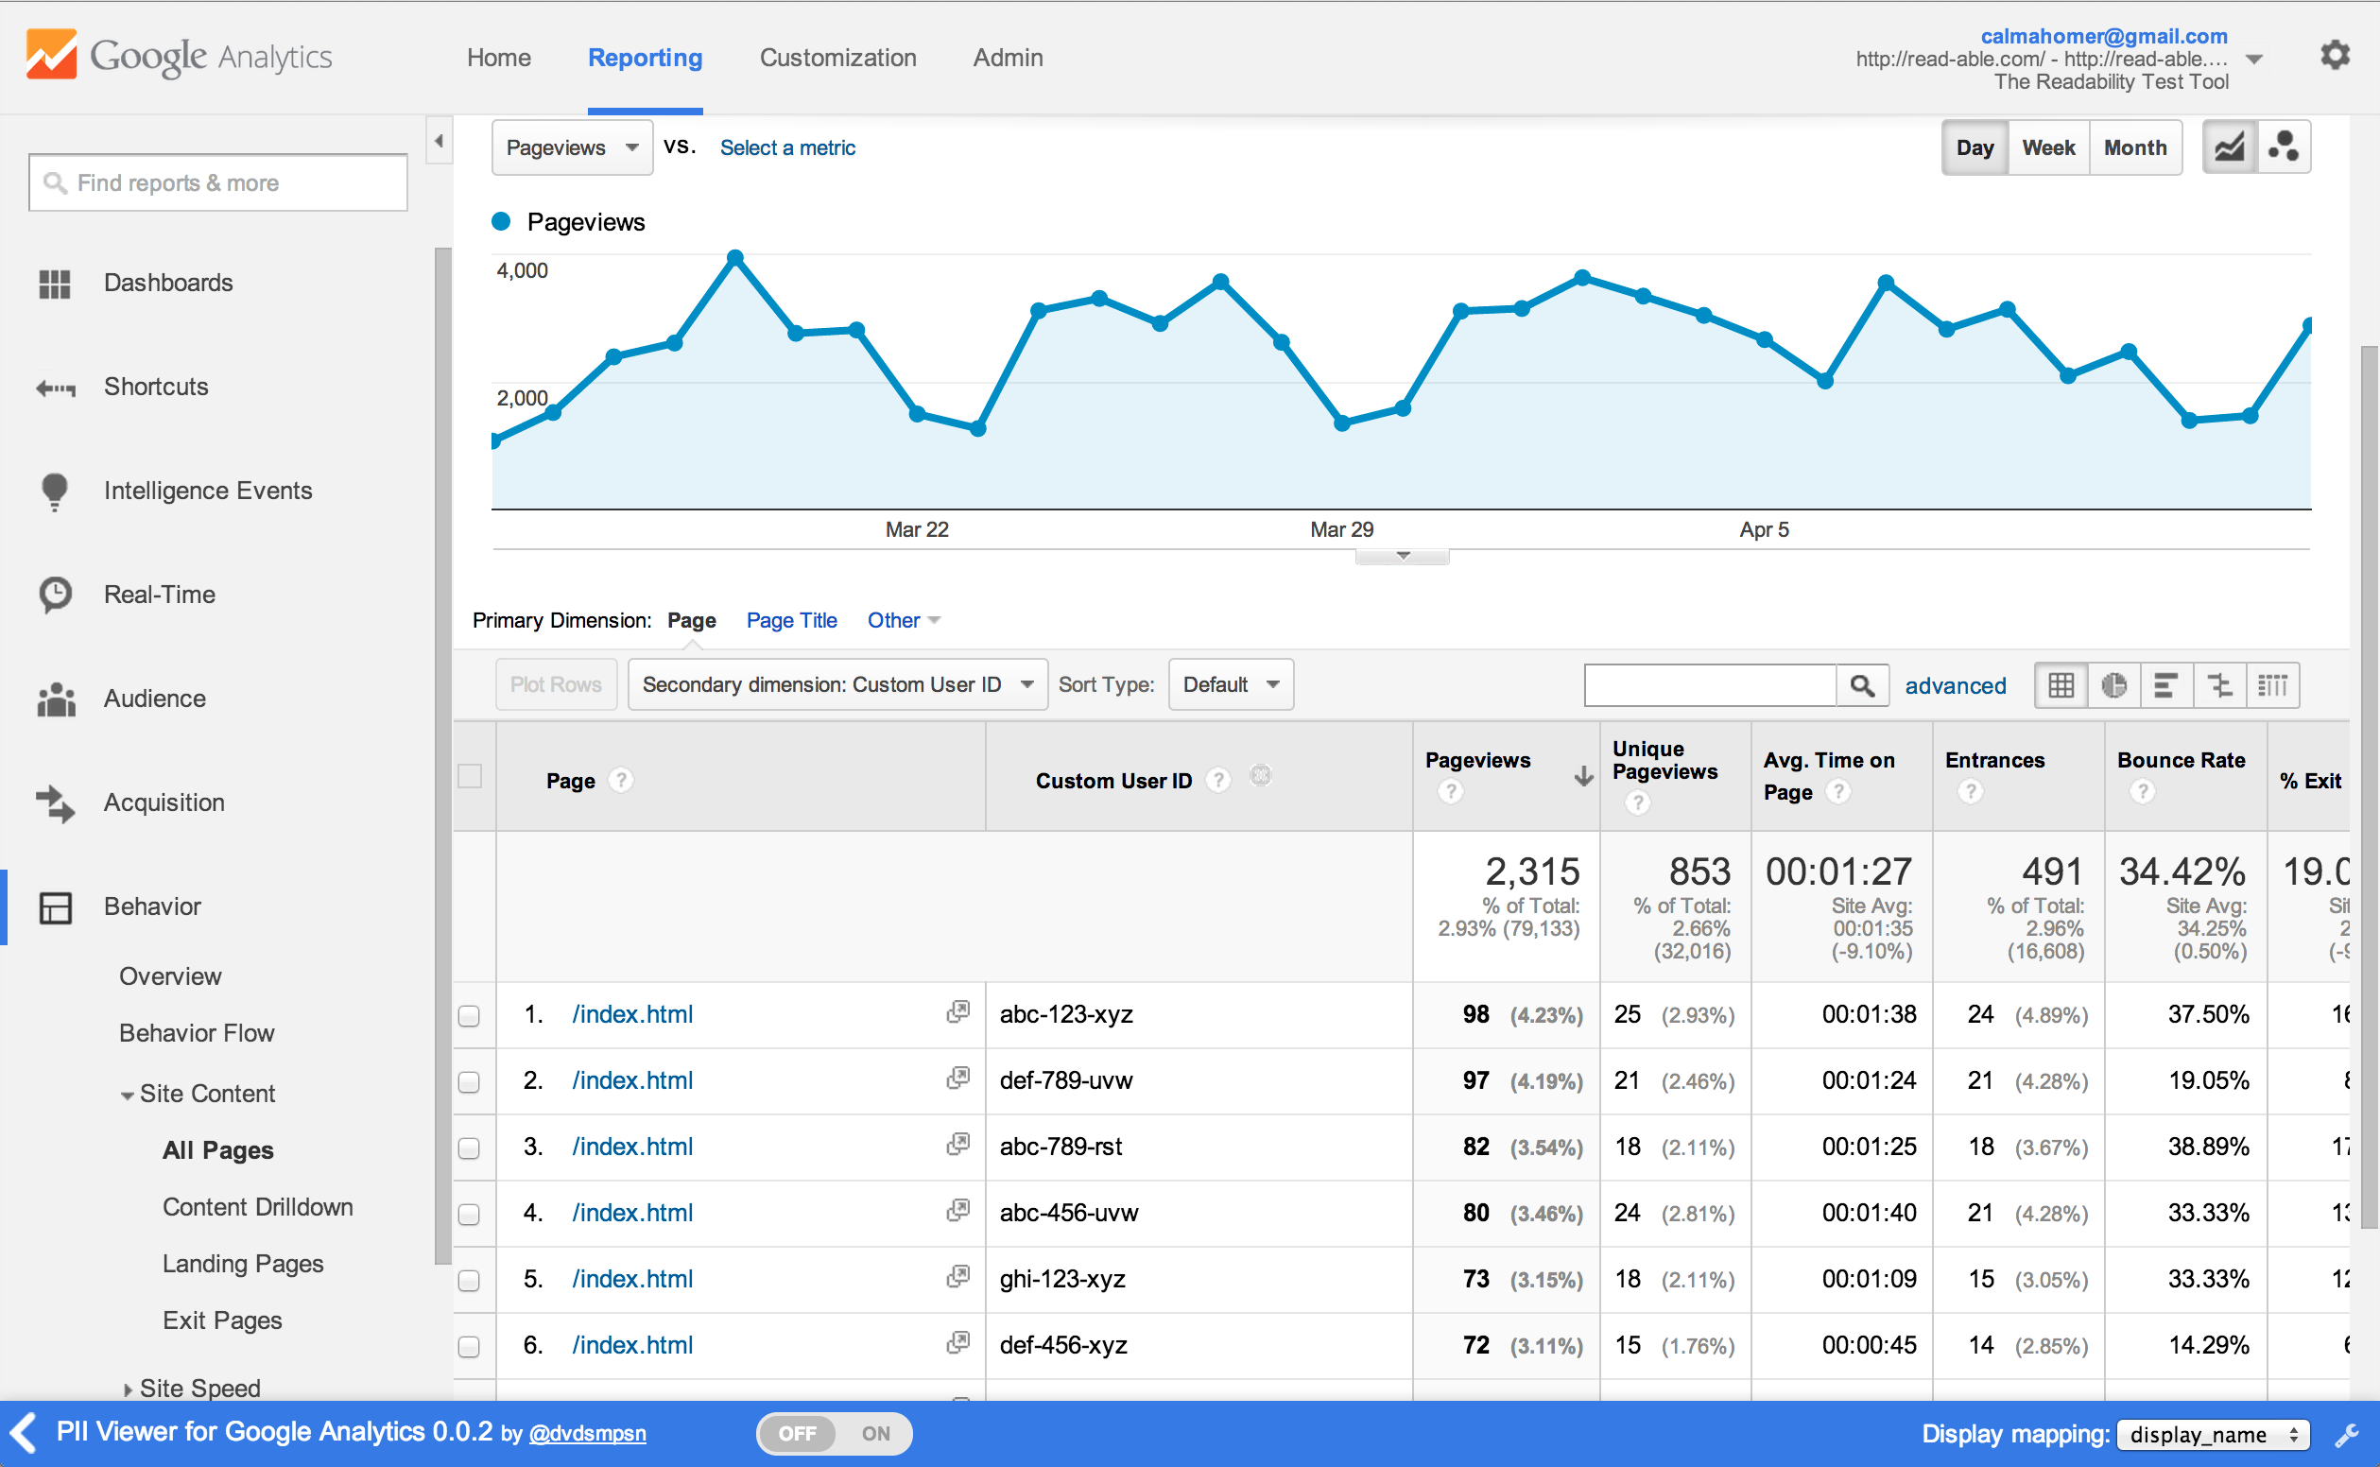
CAMPAIGN
LEADS
ANALYTICS
MEDIA
Campaigns
Archive
Current
Memorial Day Speci…
Locations (near 02143)
All Available
Previously Targeted
Café Zing, Porter Squar…
Bourbon Coffee, 1815 …
Café Rustica, 356 Beac…
Crema Café, The Atriu…
Media
All Available
Previously Used
Thu/Fri Pre-Weekend S…
Summer Weekday Spe…
12,500
923
$1,255
$1.36
All-time cork metrics
eViews
Unique Interactions
Total Spend
Cost/Interaction
Interactions
Interactions
20
10
Campaign
Campaign: Memorial Day Special 2015
i
i
i
i
i
i
 | Media Name | Estimated Views (eV) | Unique Interactions (UI) | Response Rate (RR) | Total Spend | Cost/eViews (CPeV) | Cost/Interaction (CPI)
 |  | 8,400 | 352 | 4.19% | $112.51 | $0.134 | $0.319
 | Thu/Fri Pre-Weekend Special in Cambridge.pdf | 5,100 (61%) | 286 (81%) | 5.61% | $61.88 (55%) | $0.012 | $0.216
 | Summer Weekday Special in Cambridge.pdf | 3,300 (39%) | 66 (19%) | 2.00% | $50.63 (45%) | $0.015 | $0.767

Slide 44
Awareness
User interaction with cork pushes hyper-local advertising up the marketing funnel,
adds value for both advertisers and customers.
larger audience
opportunity to persuade
targeted messaging
Consideration
Intent
Purchase
Loyalty
Advocacy

